Slide 1


Slide 2
The team
01
Table of contents
02
The Task
Technologies
03

Slide 3
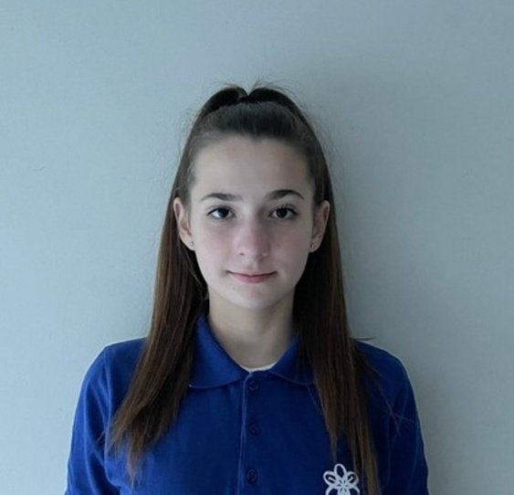
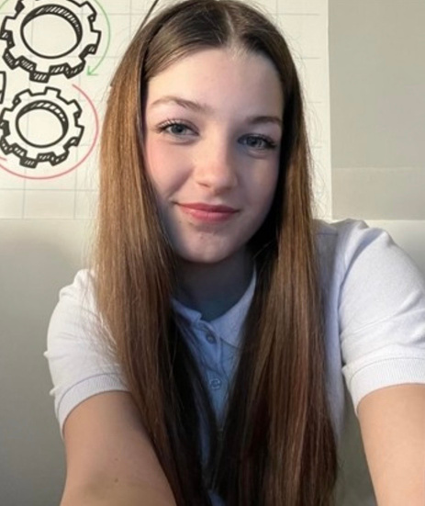
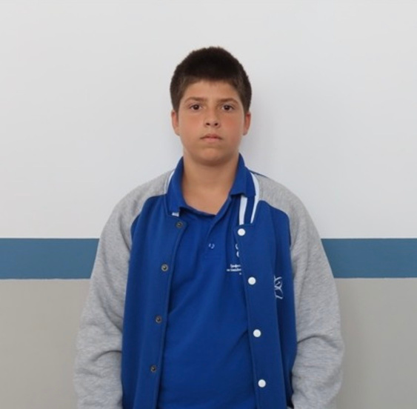
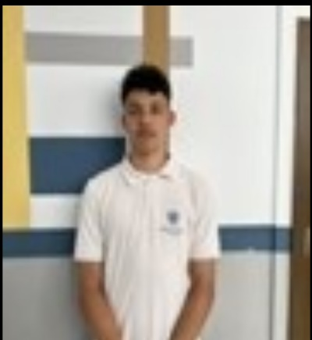
Our Team
Gabriela Badalova 9b
Emanuela Mancheva 9a
Scrum Trainer
Designer
Kaloqn Kolev 9a
Back-end developer
Lubomir Imelov 9b
Front-end developer

Slide 4
The Task
An app in which you click whether you are a parent or a student, if you are a student, you have to choose which class and which subject you want and some pages from a textbook or something to read, then it refers you to a test to solve and then the grade from the test is automatically entered into the application, and if you are a parent, you can just see the child's grades

Slide 5








Technologies​

Slide 6
Now let's take a look!

